Slide 1

Brazilian food

Slide 2
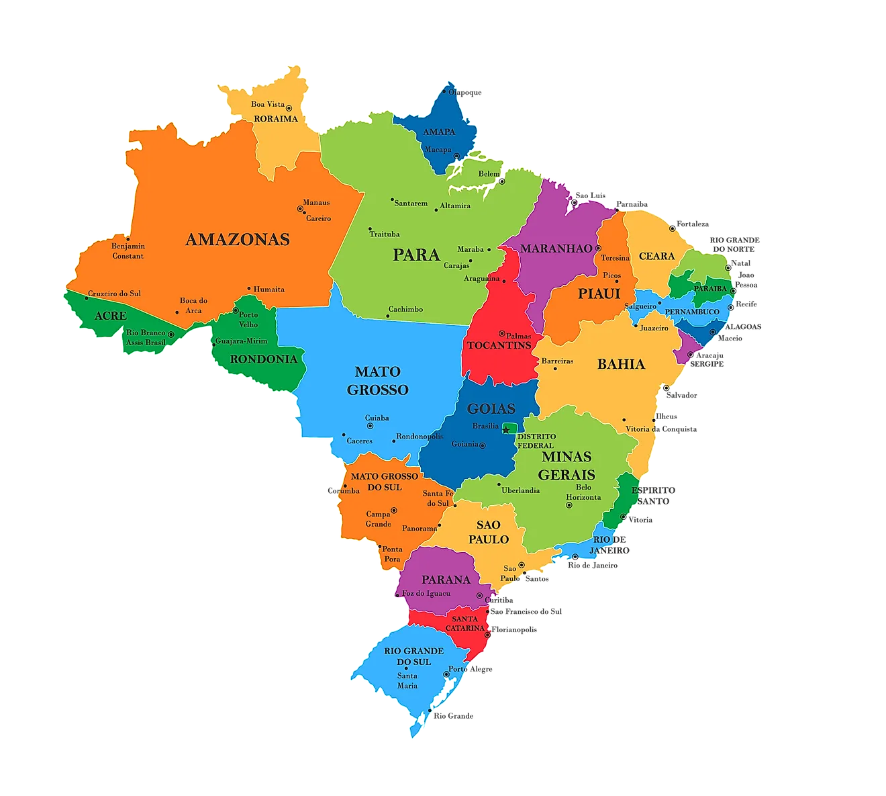
Overall aspects
Brazilian food/cuisine is fundamentally the product of the different nationalities that migrated to the country with local products and native populations.
The cuisine is highly regionalized, and it deeply varies according to the country’s main regions: North, Northeast, Southeast, South, Midwest.
During the colonial period, Brazil witnessed major migration flows, mainly from European and African countries. Therefore, the food reflects the combination of such cultures, with indigenous populations as well native to the region.

Slide 3
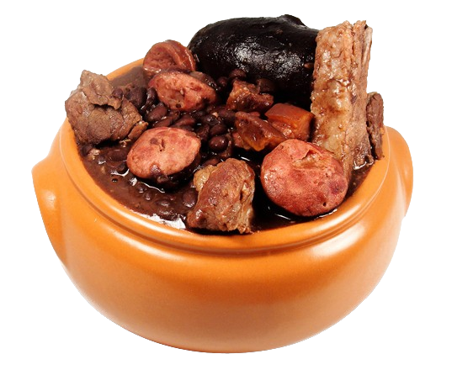
Most popular dishes
Mostly of the most popular dishes in Brazil are made of cheap and accessible ingredients, including rice, cassava, and low-cost meat, such as liver and chicken legs.
On a daily basis, people eat rice and beans, with some sort of meat. And on special occasions, such as holidays, Brazilian people usually have some sorts of fish or meat stew.
Globally, some of the most popular Brazilian dishes include brigadeiro, which is a type of fudge, Guarana, açaí bowls, and barbecue as well, which were made more popular because of TikToks and social media.

Slide 4

Restaurants/eating in Brazil
Different habits compared to the US: Brazilians usually do not eat fulfilling breakfasts, and generally eat more during lunch and dinner.
People generally do not go that often to restaurants, mainly because of inflation and limited average income.
All-you-can-eat restaurants are a big thing in Brazil, and it is quite common to find such places wherever you go.
Some Brazilian restaurants chains in the US are Fogo de Chão and Oakberry.

